Slide 1

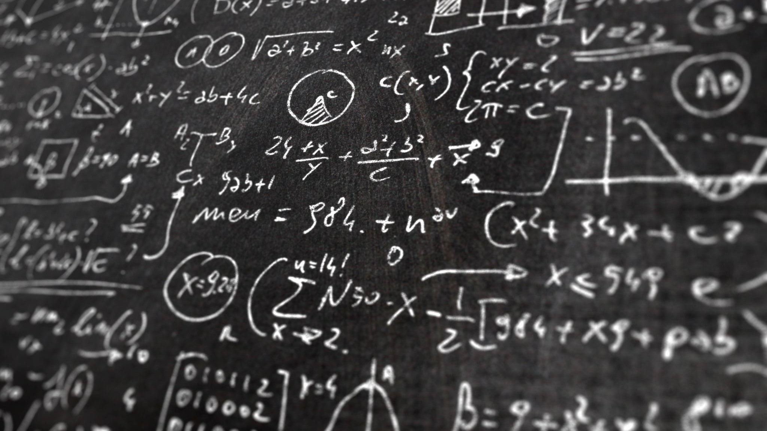
Math Information Retrieval
David Na

Slide 2
What is Math Information Retrieval?
Math IR is “concerned with finding information in documents that include mathematics”.
Document similarity and retrieval is calculated considering any math keywords and/or formulae found in the collection and query.
It’s the same as standard Information Retrieval but instead of querying just strings in documents, you query using some mathematical context.
Math IR is essentially a performing “standard” IR using Math concepts
First Math-aware search engines developed in 2000:
NIST Digital Library of Mathematical Functions (DLMF)
Examples:
Given a mathematical concept in keywords and/or formulae, find the technical papers that use similar mathematical models.
Another example is you can browse for documents containing a given formula.
Notes:
NTCIR
https://ntcir-math.nii.ac.jp/introduction/
ARQMath
https://www.cs.rit.edu/~dprl/ARQMath/2021/

Slide 3
Difficulties of Math IR
Mathematical notation is dialectic, some variables represent similar concepts but are named differently depending on the subject area
Operations can be defined in different ways depending on context. For instance, a line over a variable can be a division simple or a Boolean negation depending on context.
Math formulae can look very similar but still be very different.
Most of the time Math IR queries are combinations of keywords and formulae.

Slide 4
Types of Math IR Systems
Formula Retrieval
Example: How do you compute this formula?
Text Answer Retrieval
Example: What is a Hamiltonian Circuit?
Formula and Text Retrieval
Example: Prove a is divisible by b
Related to computation
Related to a Mathematical Concept
Related to Proofs

Slide 5
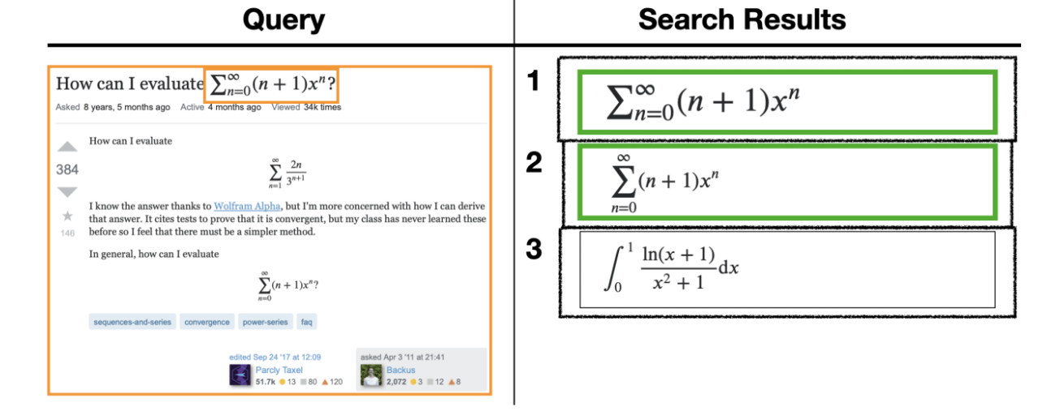
Formula Retrieval

Slide 6
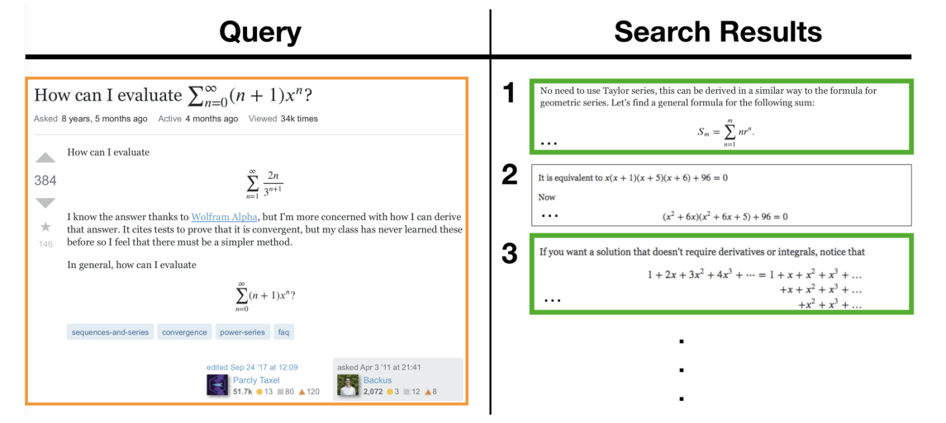
Text Answer Retrieval

Slide 7
Two Main Math IR Conferences
NTCIR – NII Testbeds and Community for Information Access Research
Run by National Institute of Informatics (Tokyo, Japan)
ARQMath - Answer Retrieval for Questions on Math
Hosted by Rochester Institute of Technology and the NSF
More Recently held in 2019-2021
Math IR was only the focus in workshops 10, 11 and 12
Held from 2014-2016
ARQMath has had 3 iterations
Notes:
https://www.cs.rit.edu/~rlaz/files/ntcir12-mathir.pdf

Slide 8
NTCIR
NTCIR 10-12 (2014-2016): Math IR
3 Main Tasks:
Formula Search: Search given a formula
Formula + Text Search: Search documents given keywords and formula
Open Information Retrieval: Search the collection given a text query
NTCIR-12 focused on the Wikipedia dataset
Wikipedia Formula Browsing: Focusing on formula search
Formula Similarity Search: Finding formulas related to the query
Two Datasets: Wikipedia was introduced in NTCIR 12
100,000 scientific articles from arXiv and 35,000 Wikipedia articles
All HTML files
Includes 30-60M math formulae
Given a set of queries, the Math IR system must return a ranked list of search results from both datasets.
Queries will be a set of formulae and keywords and you must search within the document collection
https://www.cs.rit.edu/~rlaz/files/ntcir12-mathir.pdf
Notes:
https://www.cs.rit.edu/~rlaz/files/ntcir12-mathir.pdf

Slide 9
ARQMath
ARQMath 1, 2 and 3 (2019-2021):
Focused directly on Answer Retrieval
Dataset: Question + Answer posts from Stack Exchange
Data from 2010 to 2020
28 Million mathematical formulas in LaTeX
Task 1: Finding relevant answers to a mathematical question
Given a math question as a query, search all answers and return relevant answers
Task 2: Search based on a formula
Given a question with an identified formula as a query, return relevant formulas
Task 3: Open Domain Question Answering (ARQMath 3)
Like Task 1, but now the question can come from anywhere (even written by hand). Task 1 used questions from the Stack Exchange dataset as input. Task 3 can take as input any query.
http://sigir.org/wp-content/uploads/2020/12/p06.pdf
Notes:
ARQMath 2 included more baseline models and actual training data
Answer Retrieval for Questions on Math
https://www.cs.rit.edu/~rlaz/files/ARQMath_2022_Overview_WorkingNotes.pdf

Slide 10
Representing Math Formulas
MathML
Tangent-CFT
LaTeX
Symbol Layout Trees (SLT)
Operator Trees (OPTs)
XML Format
HTML <math> tag
Standard
Commonly used in PDFs

Slide 11
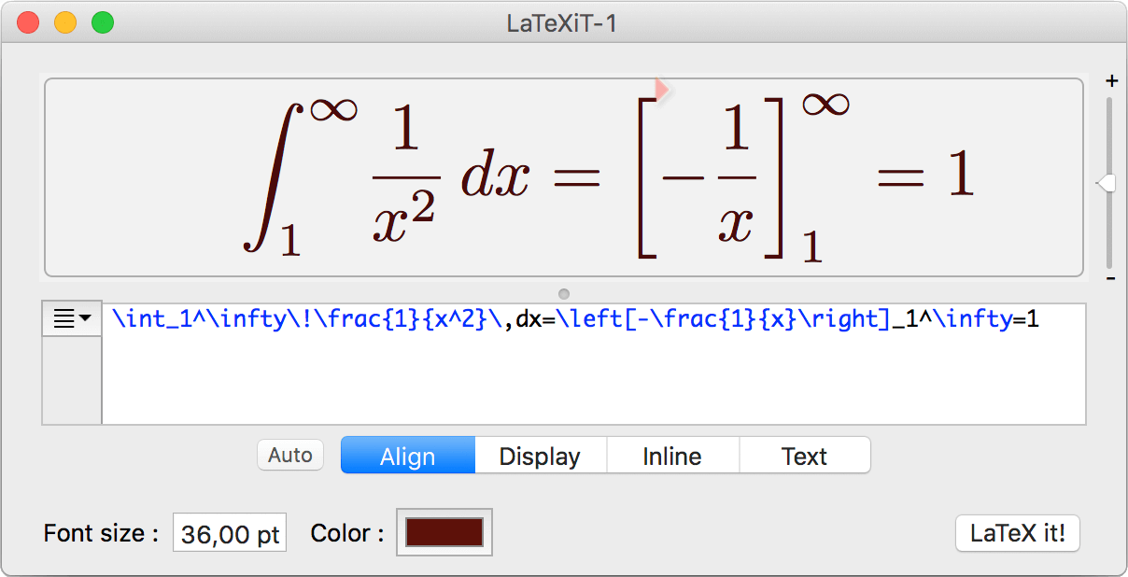
LaTeX
Reference: http://www.malinc.se/math/latex/basiccodeen.php
Notes:
http://www.malinc.se/math/latex/basiccodeen.php

Slide 12
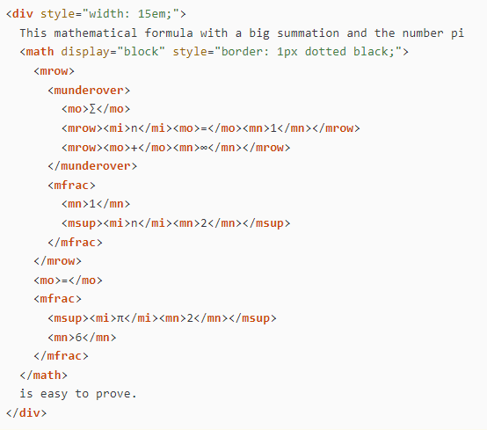
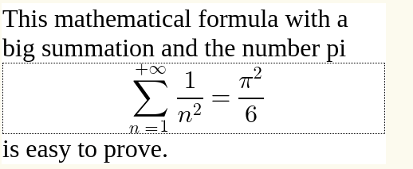
MathML
Reference: https://www.w3.org/TR/mathml-core/

Slide 13
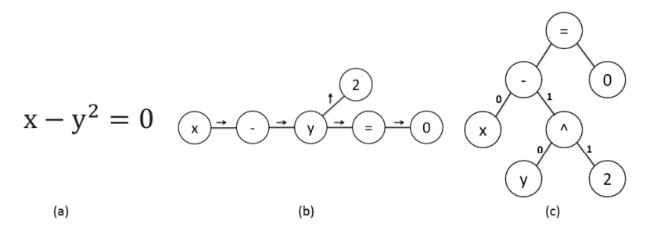
Tokenizing Mathematical Formulae
Formula
Symbol Layout Tree
Operator Tree
Reference: https://clgiles.ist.psu.edu/pubs/IDTIR2019.pdf

Slide 14
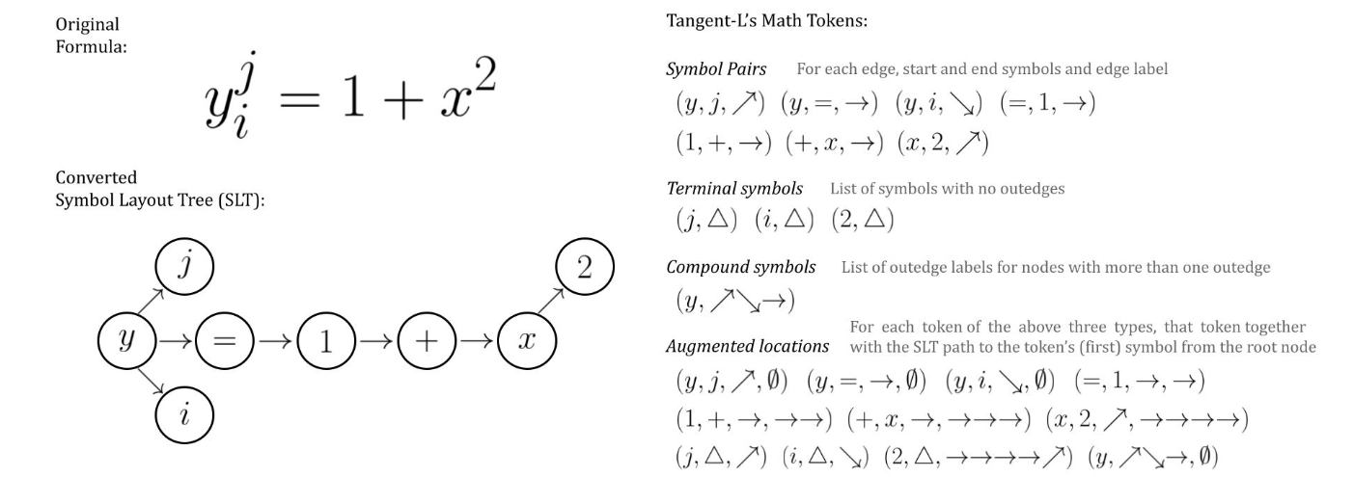
Tokenizing Mathematical Formulae – Tangent-L and SLT
A detailed animation provided here: https://www.scg.uwaterloo.ca/brushsearch/tangent-l/

Slide 15
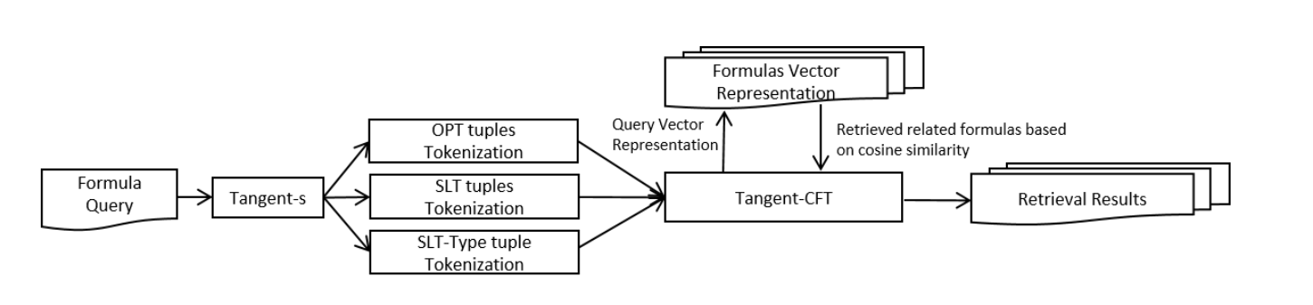
Baseline Math IR System – Tangent-CFT
Reference: https://clgiles.ist.psu.edu/pubs/IDTIR2019.pdf

Slide 16
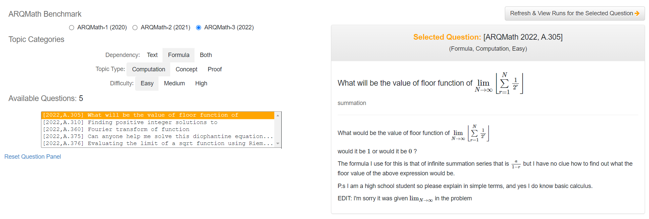
Inspiration: MathDowsers
Reference: https://cs.uwaterloo.ca/~yk2ng/MathDowsers-ARQMath/ & https://ceur-ws.org/Vol-3180/paper-03.pdf
Notes:
Submission to ARQMath 1,2 and 3

Slide 17
My Math IR System
GitHub: https://github.com/davidna22/math-IR-ARQMath-CompuBERT
Overview:
My math IR system was created following the ARQMath workshop. My primary goal was to create an IR system capable of vectorizing q+a pairs from the ARQMath dataset, in order to be able to take in a math query and return a ranked list of documents matching that query. I chose to develop my system following Task 1 of the ARQMath workshop.
Dataset:
Math Stack Exchange posts from 2010-2021
Data preprocessing was provided by ARQMath and found on their github
I implemented their preprocessing, added some others that I found online in papers
Architecture:
I use a variation of a model called CompuBERT (Novotny et al.) that I found very interesting. It utilizes pre-trained Transformer models such as BERT to create feature embeddings for question answer pairs. Using those feature embeddings, I can compute cosine similarity scores and return a ranked list of documents. Most of my code was taken from their open-source implementation (https://github.com/MIR-MU/CompuBERT) as it was one of the first transformer-encoder models and easiest to implement.

Slide 18
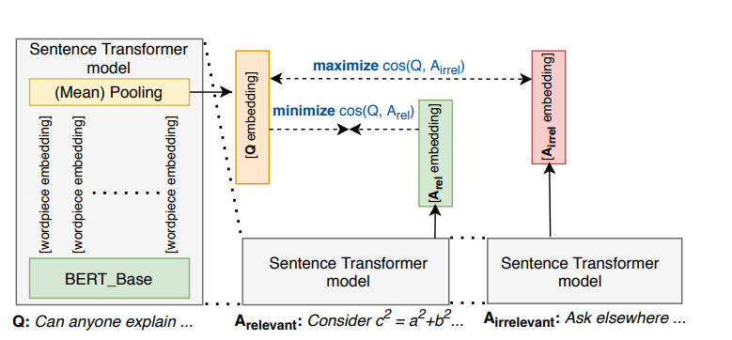

Compubert
The Model relies on the feature vector embeddings generated by the BERT model and uses cosine similarity to find the best answers per query
The overall results of the this first transformer model was poor relative to other submissions, so part of my experiment was to test how it will perform with a newer pre-trained model
Since CompuBERT, other Transformer models have been implemented to success. This (given my lack of experience) was the easiest to implement and thus, a good starting point for me.
Reference: https://ceur-ws.org/Vol-2696/paper_235.pdf

Slide 19
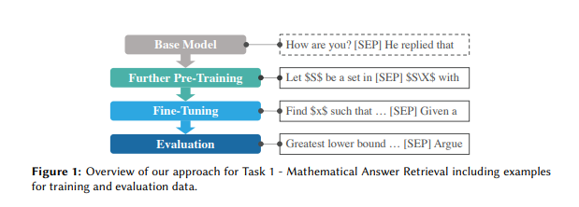
Transformer-Encoder and Decoder mdoels
Reference: https://ceur-ws.org/Vol-3180/paper-07.pdf

Slide 20
Transformer-Encoder and Decoder mdoels
Reference: https://ceur-ws.org/Vol-3180/paper-07.pdf

Slide 21
My Model
Math-aware ALBERT - https://huggingface.co/AnReu/math_albert
ALBERT for ARQMath 3
MPNet – Trained by Microsoft
MathBERT
Embeddings are calculated for all corpus documents and stored on disk
Query Embeddings are passed and Cosine Similarity Score is calculated
Ranked List of Documents is returned to the User

Slide 22
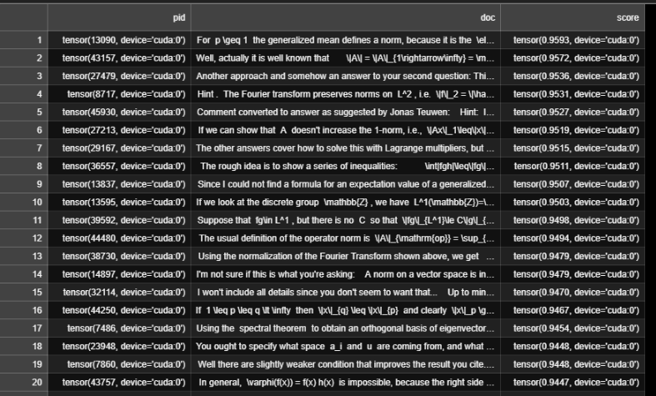
results
 | MPNet | Math-Aware Albert | Albert for Math 3 | MathBERT
f1 Scores | 0.699 | 0.626 | 0.691 | 0.644
Precision | 0.544 | 0.532 | 0.54 | 0.527
Accuracy | 0.546 | 0.51 | 0.538 | 0.506

Slide 23
To-Do list
Trying different Transformer Models
There have been new iterations of CompuBERT that have had high performance. An example is found in this paper, Transformer-Encoder and Decoder Models for Questions on Math (https://ceur-ws.org/Vol-3180/paper-07.pdf).
Training on a larger subsample of the dataset
Training on the entire dataset would have taken me about a full month of constant training given the size of the corpus and the size of the models I chose.
Bunch of limitations such as GPU RAM and compute power that I would need to pay for via cloud to train effectively
Applying different transformations in text preprocessing
Math text preprocessing is very different from standard IR, so I would love to do more research and apply different preprocessing techniques
Attempting Task 2 and 3 of the ARQMath competition
Task 2 is very different as I would need to fully implement a math-only textual embedding. Most likely requiring the use of symbol trees (Tangent-CFT) and something called Formula2Vec.

Slide 24
References
NTCIR-12 MathIR Task Overview
https://www.cs.rit.edu/~rlaz/files/ntcir12-mathir.pdf
NTCIR Website
https://ntcir-math.nii.ac.jp/introduction/
ARQMath: A New Benchmark for Math-Aware CQA and Math Formula Retrieval
http://sigir.org/wp-content/uploads/2020/12/p06.pdf
ARQMath Website
https://www.cs.rit.edu/~dprl/ARQMath/2021/
Tangent-CFT: An Embedding Model for Mathematical Formulas
https://clgiles.ist.psu.edu/pubs/IDTIR2019.pdf
Math ML Docs
https://www.w3.org/TR/mathml-core/
Latex Docs
http://www.malinc.se/math/latex/basiccodeen.php
CompuBERT
https://github.com/MIR-MU/CompuBERT
Three is Better than One: Ensembling Math Information Retrieval Systems
https://ceur-ws.org/Vol-2696/paper_235.pdf
Transformer-Encoder and Decoder Models for Questions on Math
https://ceur-ws.org/Vol-3180/paper-07.pdf

